Slide 1
E-Cube (Unsupervised Text Analytics NLP Model & Web Framework)
Rakesh Kedar
February 21, 2022

Slide 2

Intro to E-Cube Web Framework
What is E-Cube?
A Natural Language Processing (NLP) model that mines categories / themes
from textual data - Entity Extraction Engine
Input Data (Text Corpus): Output (Clusters / Themes)
How old are you?
What is your age?
My phone is good
My age is 20
Your cellphone looks great
This is quite a good phone
Why we need it?
Identify work drivers by classifying or grouping similar ticket patterns or themes.
Almost 1 million tickets generated every 3 months. Hence it is paramount to cluster them in categories to derive meaningful information.
Ticket trends can be identified from historical / timeline based views.
Helps Problem Managers and stakeholders of respective services to mitigate top issues and reduce ticket count.
User friendly experience in the world of text analytics
Entity1: Old, age
Entity2: Phone, cellphone, good, great

Slide 3





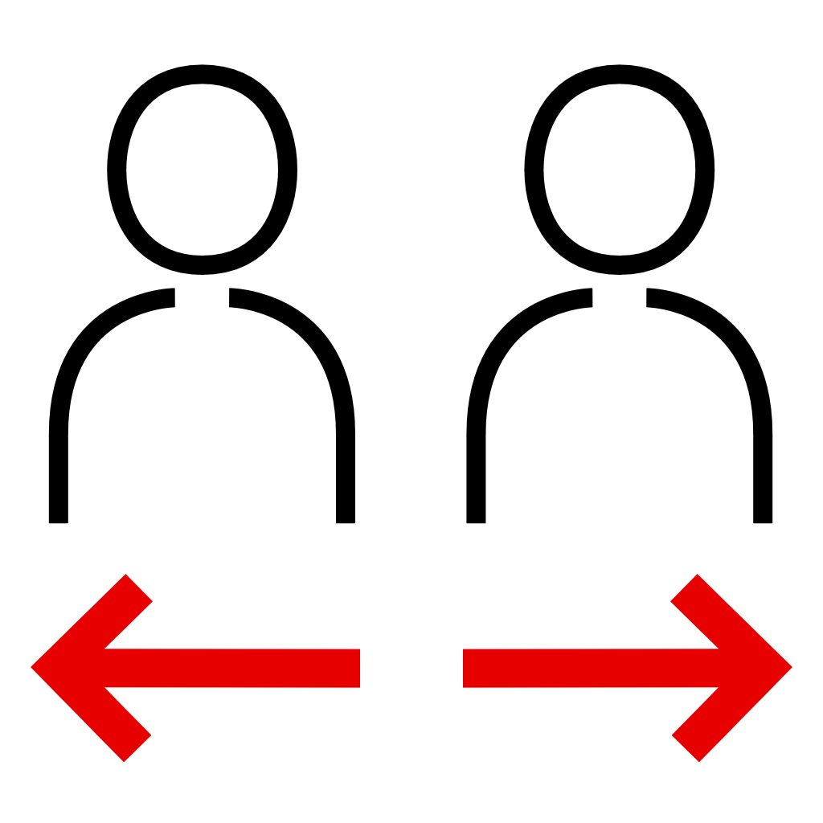
Project Overview & Challenges
Solution
Decision of building a user interface & self serving utility in order to allow users to perform their own analysis & compare the output on the web portal
Learned completely new technology / skill to develop user friendly web portal in house within very short period of time
Decided to come up with new prototype which allows user engagement & manage the performance issue.
Developed solution of job scheduling & progress update at the user interface level.
Challenges
Developer dependency to support Adhoc requests coming from end user to perform analysis on data.
Lack of UI expertise/skills in the team.
User engagement & performance issues due to increasing number of users on the web portal.
Multiple users to perform analysis at same time.
User Engagement & Requirements
Dashboard view on ticket patterns from all services impacted
Visualization layer on portal to identify groups & hidden patterns.
Progress notification to keep users informed about the progress of current analysis.
Analysis output availability on portal up to certain period of time.

Slide 4
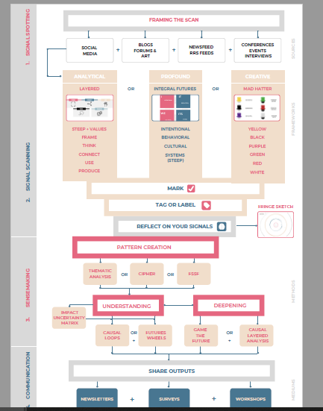
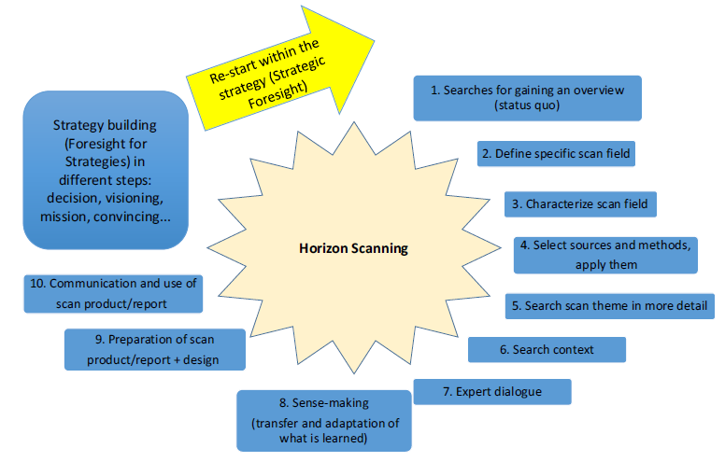
Horizon Scanning Tool Approach & Challenges
Horizon Scanning is the systematic outlook to detect early signs of potentially
important developments. These can be weak (or early) signals, trends, wild cards or
other developments, persistent problems, risks and threats, including matters at the
margins of current thinking that challenge past assumptions.

Slide 5
Top Free Open Source Online Tools to use
Tools for signal spotting
RSS Feed Reader
Flipboard - https://www.flipboard.com/
Feeder – https://feeder.co
Social Media Analyses
Hootsuite – https://hootsuite.com
TweetDeck – https://tweetdeck.twitter.com
Trend Databases
WEF’s strategic intelligence – https://intelligence.weforum.org/
Google Trends – https://trends.google.de/trends
Tools for signal scanning
Flipboard – https://www.flipboard.com/
Pearltrees- https://www.pearltrees.com/
Padlet – https://de.padlet.com/dashboard
Airtables – https://airtable.co
Tools for communicating the output
Newsletter
Mailchimp - https://www.mailchimp.com/
HubSpot’s – https://hubspot.com/
Result presentation
Padlet - https://de.padlet.com/dashboard
Airtables – https://zapier.com/
Stacker – www.stackerhg.com/n
Surveys
Typeform – https://typeform.com/
Surveymonkey – https://surveymonkey.com/
Tools for pattern creation & sensemaking
Padlet – https://de.padlet.com/dashboard
Miro (workshop / whiteboard - https://miro.com/app/
Mural – https://mural.co/
Airtables – https://zapier.com/
Kumu (powerful visualization platform) - https://kumu.io/

Slide 6
References
Horizon Scanning in Foresight – Why Horizon Scanning is only a part of the game
https://onlinelibrary.wiley.com/doi/10.1002/ffo2.23
Models of Horizon Scanning - How to integrate Horizon Scanning into
European Research and Innovation Policies
https://www.researchgate.net/publication/303403699
On concepts and methods in horizon scanning: Lessons from initiating policy
dialogues on emerging issues
https://www.researchgate.net/publication/224753726
Horizon scanning practical guide – Tips & Tricks https://eionet.kormany.hu/akadalymentes/download/2/bf/b2000/Horizon_Scanning_Guide.pdf

